Slide 1

HOSPITAL NETWORK DESIGN
​​

Slide 2


Members of Group 1:
Tshifhiwa Letlalo (Leader) ST10161290
Given Mogowe (Secretary) ST10070150
Noko Mashiane ST10213884
Lebohang Marina Shai ST10106088
Fahima Patel ST10207945

Slide 3
Agenda
Introduction
Purpose
Context
List of needs
Project Specification
Network Requirements Analysis
Expected Features
Desired Improvements
Network Diagram
Network Topology
Conclusion

Slide 4

INTRODUCTION​
Since we live in the fourth industrial revolution, our vision and mission is to implement a new system software that will help the future of our healthcare infrastructure. The aim is to create a network infrastructure that allows networks to connect and communicate between devices, users, and the internet. Its offering a simpler way for data to move from one hardware to another.
​

Slide 5

OBJECTIVES
1. Delivering carrier-class performance
2. Flexibility
3. Scalability
4. End-to-end security
5. Operational simplicity

Slide 6
PURPOSE
The point of this project is to build a network infrastructure that connects devices, software, and hardware in the network. Also allows communication between users and addresses all the concerns raised by the hospital IT Manager
So, in this project, we will be designing a cost effective network infrastructure for the hospital with the demonstrations needed.​
​

Slide 7
CONTEXT
The context of our hospital network infrastructure refers to the underlying technological framework that supports the communication and data exchange within a hospitals various departments, facilities and systems. This infrastructure typically includes hardware, software, networking components, security measures, and data management systems that allow different medical devices, computers, and personnel to interact efficiently and securely.

Slide 8


List of needs:
Security
Interoperability
Productivity
Flexibility
Availability

Slide 9
Project Specifications:
These are the tasks, activities and deliverables that need to be completed as part of this project. The scope of our scope includes network infrastructure, which is going to be the servers, routers, switches, and cabling infrastructure. Also included is the security. These security measures are firewalls, intrusion, detection systems and data encryption to protect patient information and ensure compliance with health care regulations.

Slide 10
Network Requirement Analysis
Main Block Requirements:
Central Server for Hospital Management Software
15 Computers for the Billing Section (Ground Floor)
135 Computers for Practitioners (5 Floors)
Switches and Routers for Connectivity
Network Cabling (Less than 70 meters between floors)
Hardware Requirements Analysis in Wards:
5 Floors in Each Ward
10 Computers and Printers on Each Ward's Ground Floor
Scalability for Future Expansion (additional computers)
Dynamic IP Addressing:
Central DHCP Server for Dynamic IP Allocation
Loop-Free Layer 2 Network:
Implement Spanning Tree Protocol (STP) or other loop prevention mechanisms

Slide 11
Expected features
Communication speed
File sharing
Back up and roll back is easy
Software and Hardware sharing
Security
Scalability
Reliability

Slide 12
Desired Improvements:
Enhance Network Performance: The network should be capable of handling increased traffic without performance degradation.
Strengthen Security: Implement advanced security measures to protect patient data and ensure compliance with HIPAA regulations.
Enhance Redundancy: Introduce redundancy and failover mechanisms to minimize downtime in the event of hardware failures.
Scalability: Design the network to accommodate future growth in terms of devices and users.
Streamline IP Address Management: Implement dynamic IP address assignment to streamline network management processes.

Slide 13
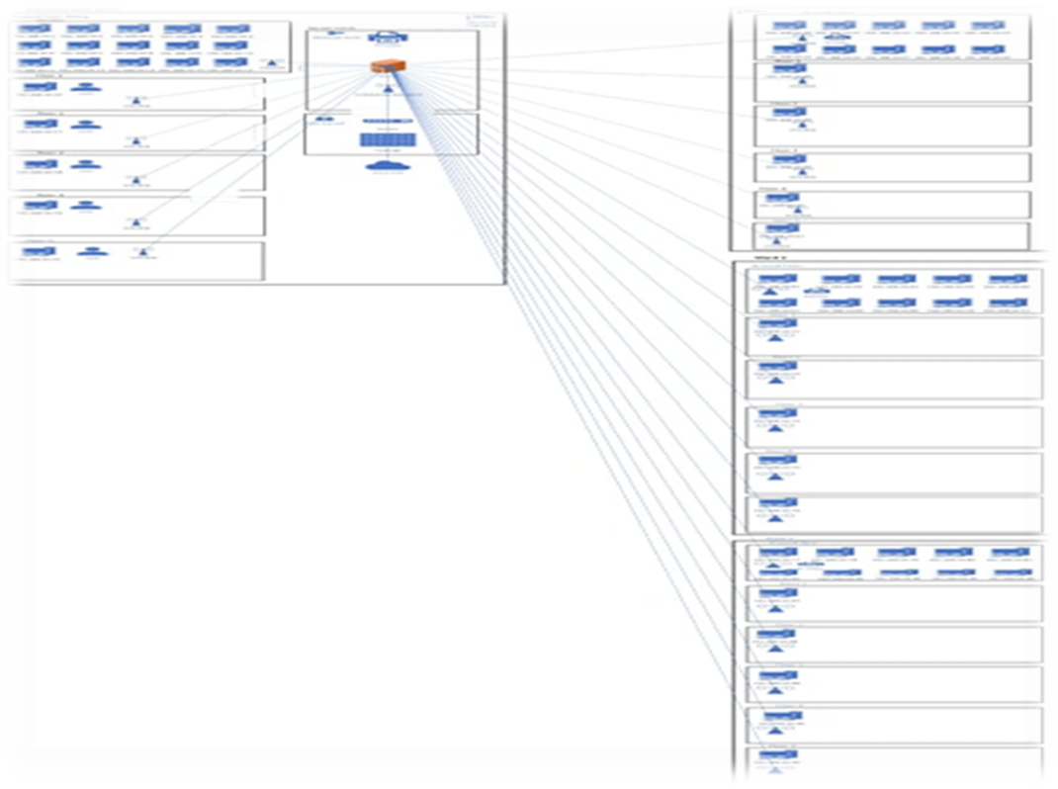
Network Diagram:

Slide 14
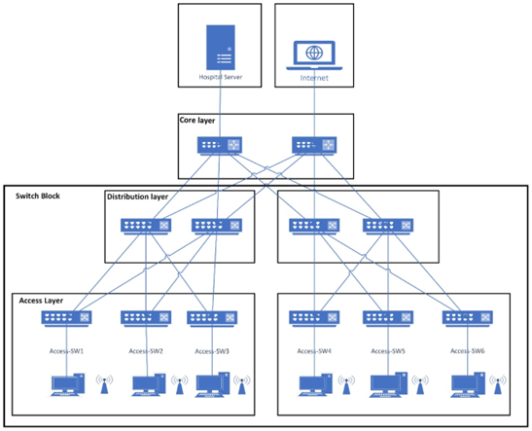
Network Topology (Tree Topology):

Slide 15
Potential Risks:
Security breaches
Hospitals deal with sensitive patient data, making them attractive targets for cyberattacks.
Data privacy and compliance
Hospitals must comply with various data privacy regulations
Infrastructure failures, compatibility issues
Network outages, server crashes, or other infrastructure failures can disrupt critical healthcare operations, potentially leading to life-threatening situations.
Budget overruns
Hospital network projects can be costly, and cost overruns can strain the hospital's budget.
Staff resistance and training
Hospital staff may be resistant to changes in the network infrastructure.
Downtime and service interruptions.
Transitioning to a new network can lead to temporary service disruptions.

Slide 16

Conclusion
In conclusion, the design of the hospital network is crucial for ensuring efficient and effective healthcare delivery. By implementing a well-planned and robust network infrastructure, hospitals can benefit from enhanced communication, streamlined operations, and improved patient care.
A properly designed hospital network allows for seamless communication and information sharing among various departments, healthcare professionals, and patient services.
​

Slide 17

Thank You.

